Slide 1
Project ASCEND!
Embry-Riddle Aeronautical University
Fall 2015 & Spring 2016

Slide 2
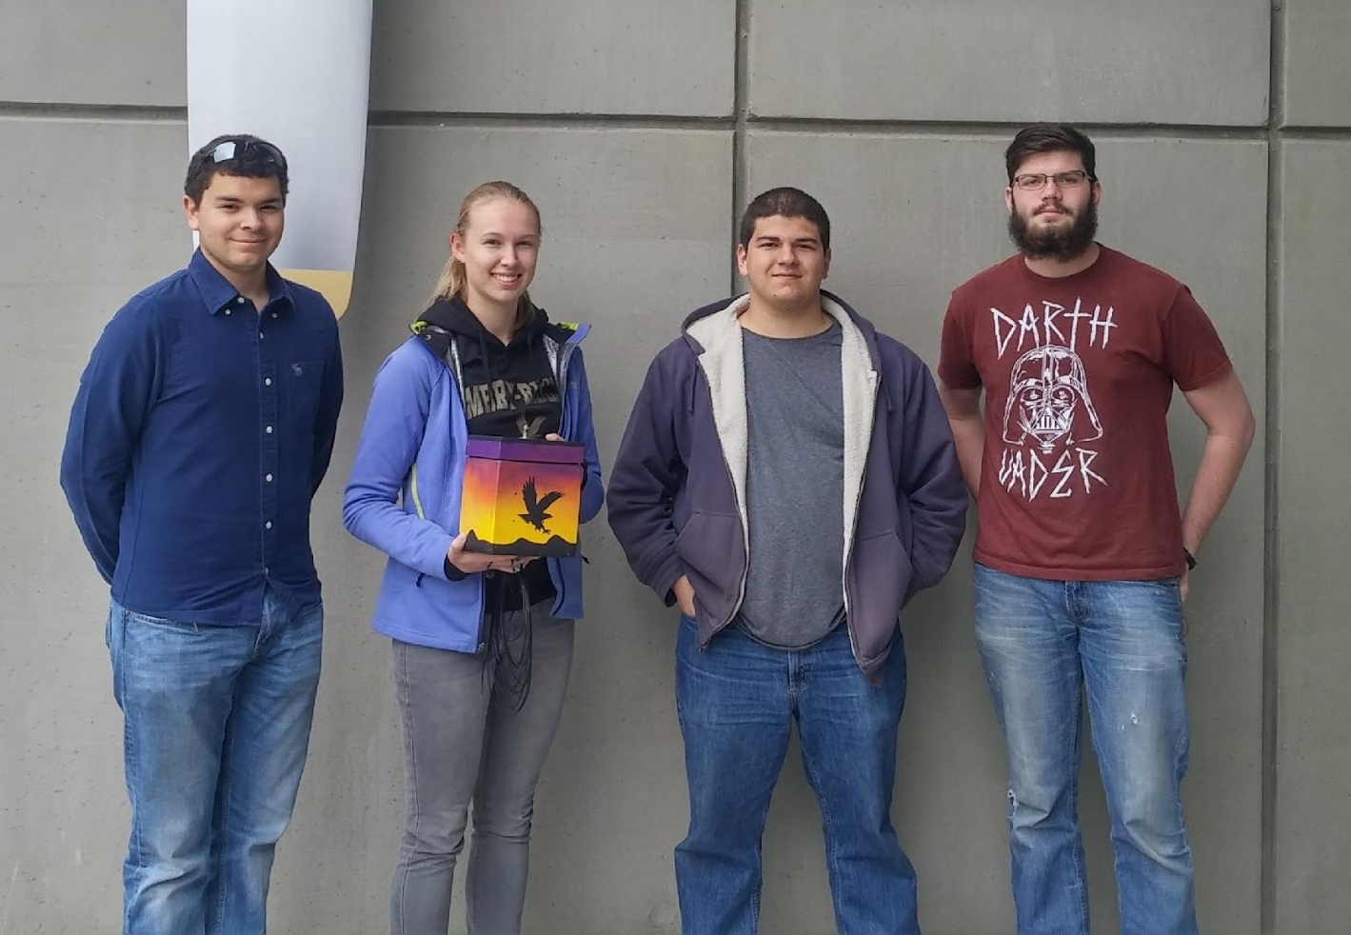
Team Organization
Joseph Mena: PM, Electrical – Middle left
Rachael Rise: Structures – Middle right
Bryan Schaefer: Structures – Far left
Tom Skoda: Software – Far right

Slide 3
Fall 2015
The Experiment
3 solar panels
Testing current output of panels
Solar panels were to be tested for EagleSat

Slide 4
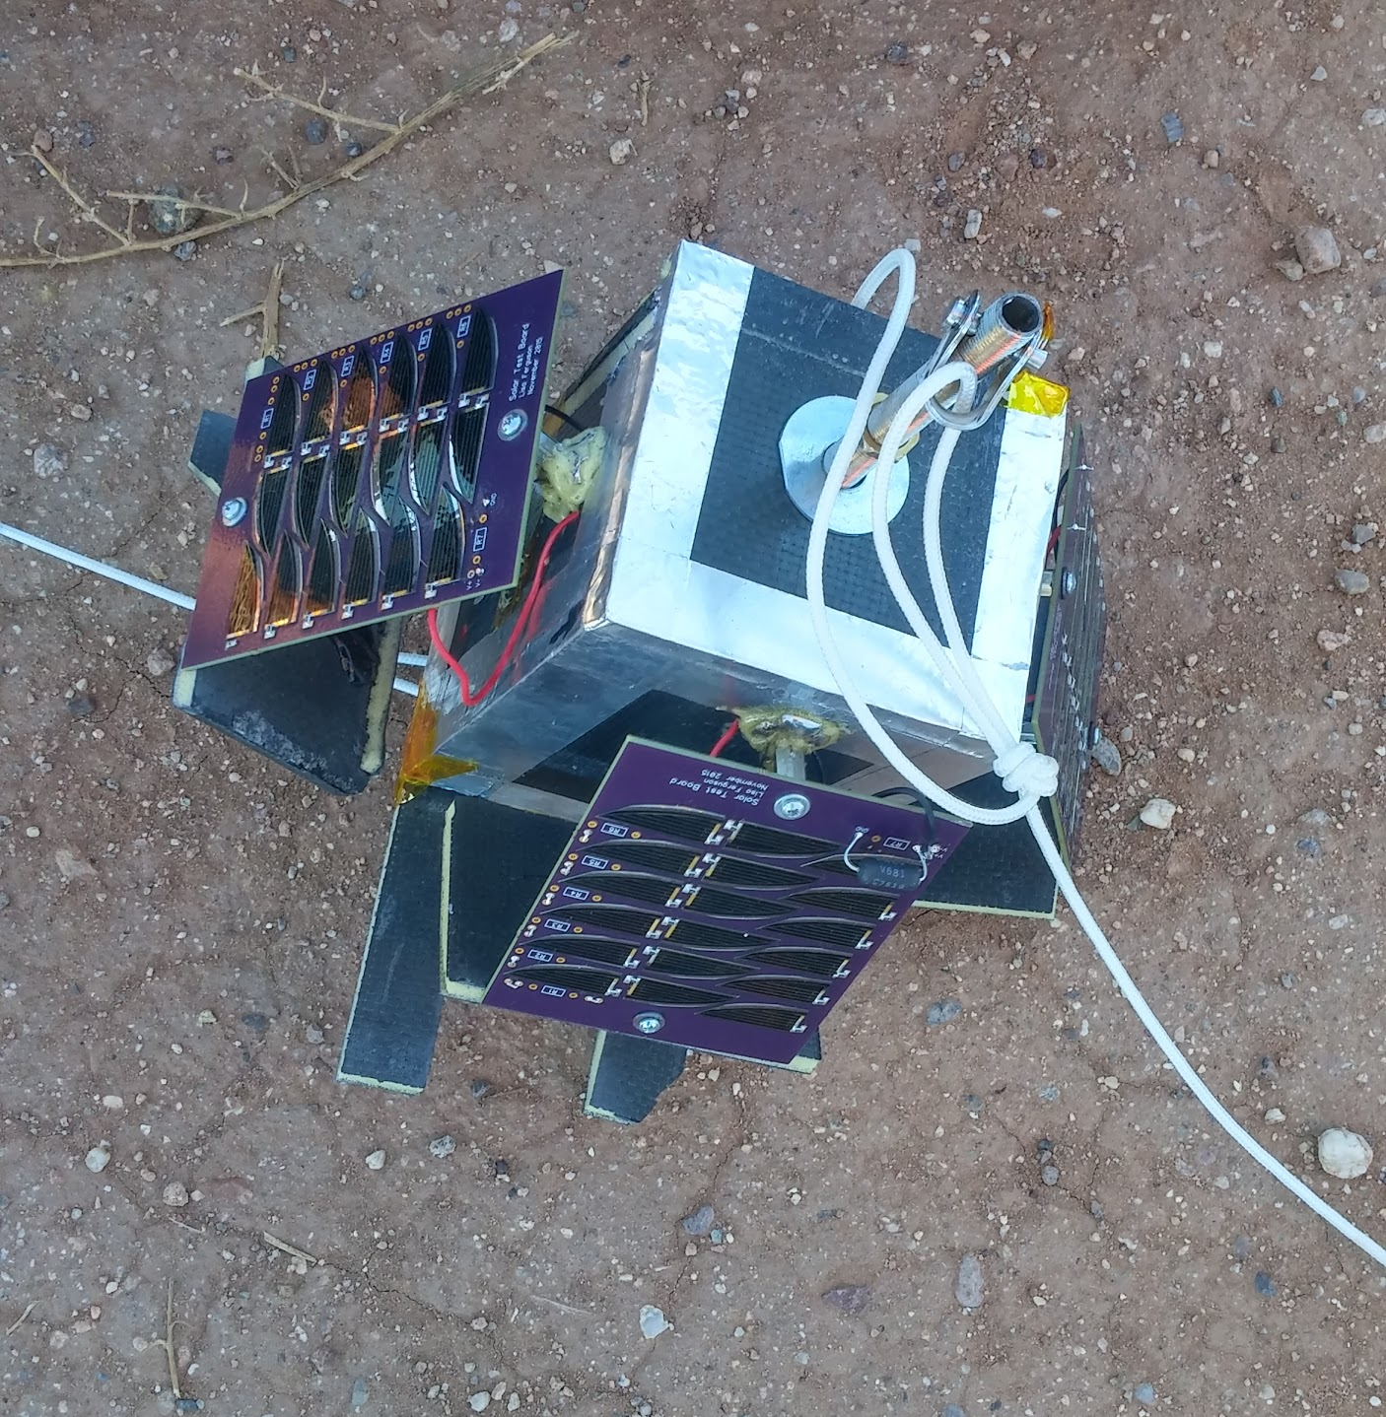
Fall 2015

Slide 5
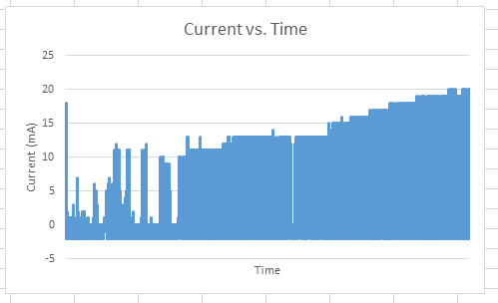
Fall 2015

Slide 6
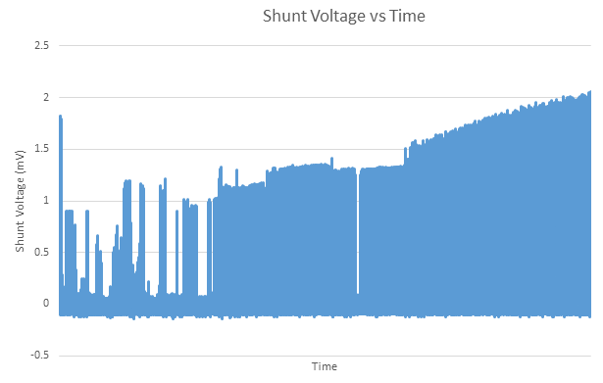
Fall 2015

Slide 7
Spring 2016

Slide 8
Spring 2016
The Experiment
Measuring roll, pitch, and yaw with 9 DOF
1080p 30fps Raspberry Pi camera

Slide 9
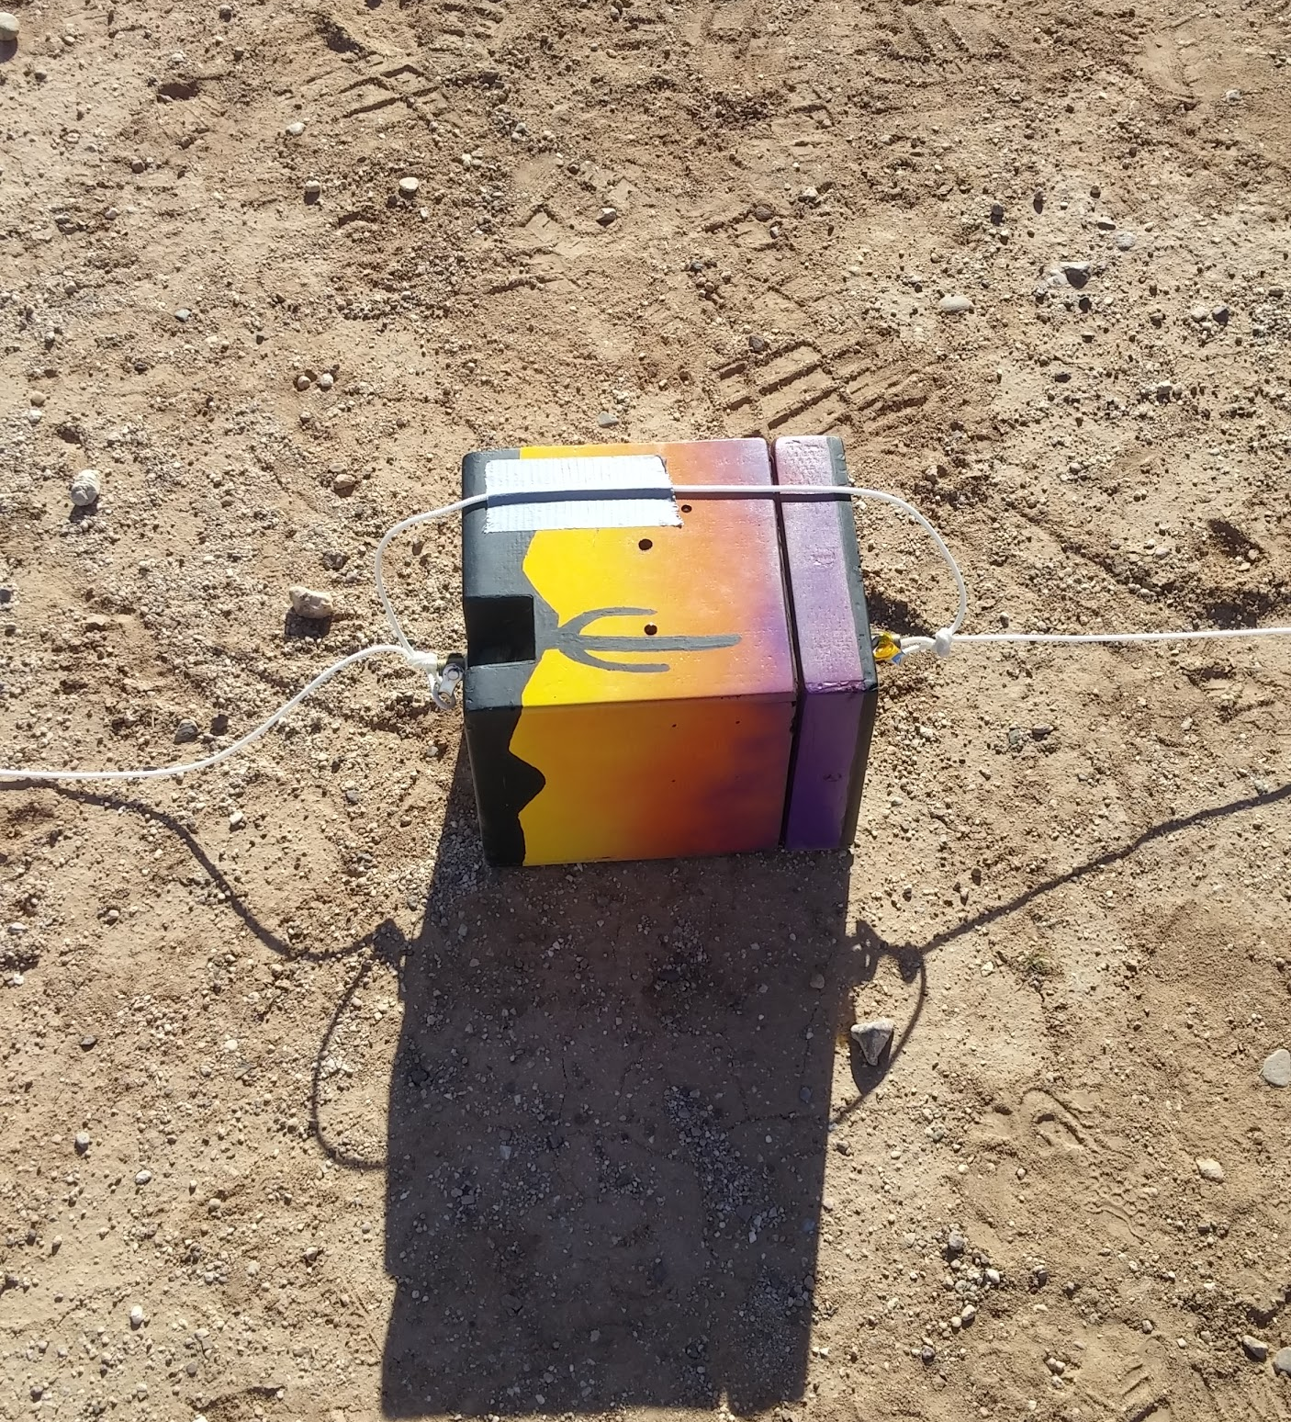
Spring 2016

Slide 10
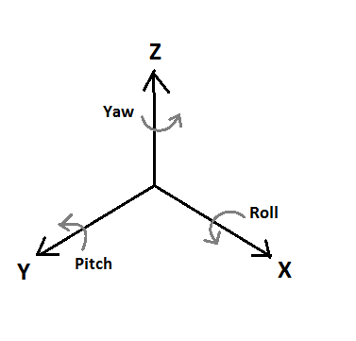
Spring 2016

Slide 11
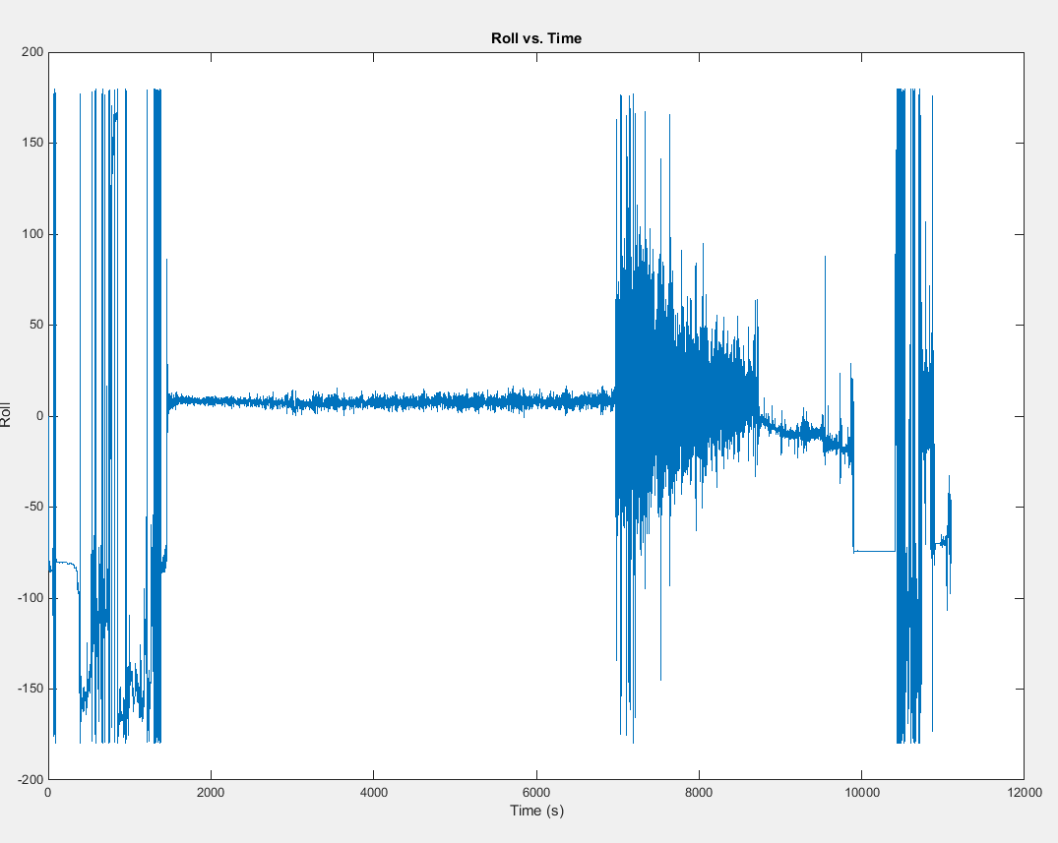
Spring 2016

Slide 12
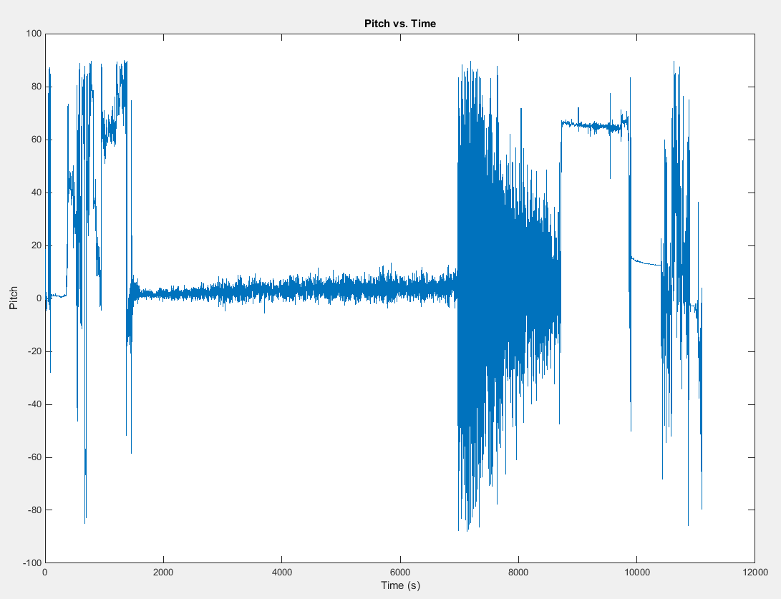
Spring 2016

Slide 13
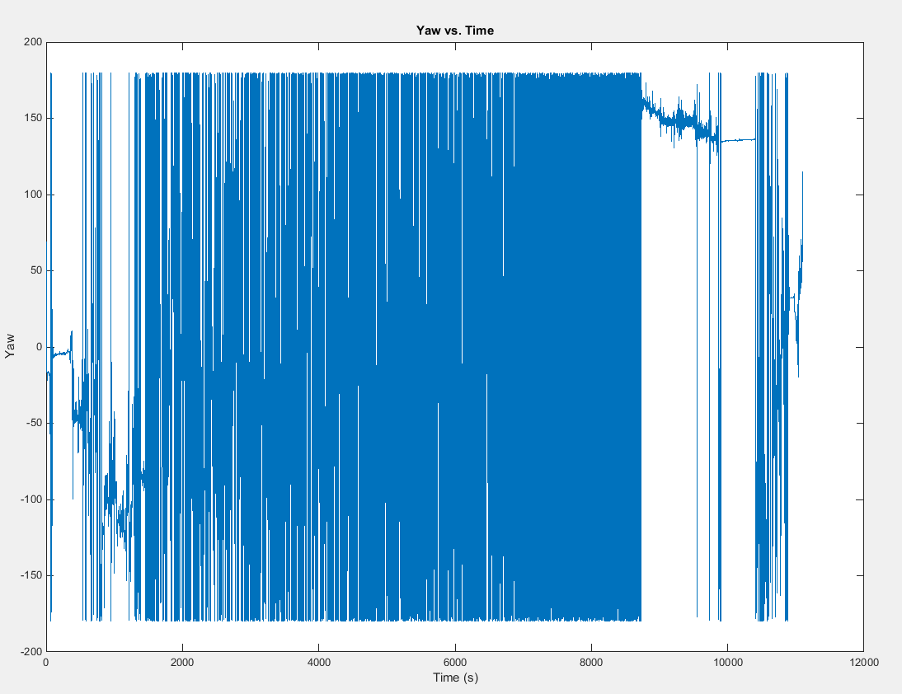
Spring 2016

Slide 14
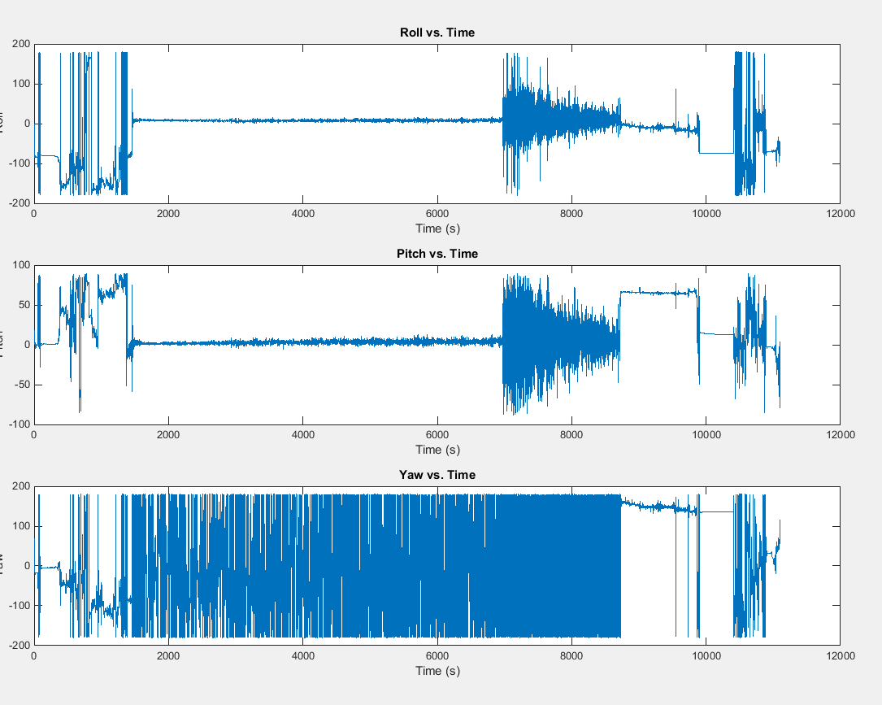
Spring 2016

Slide 15



Acknowledgements
Dr. Gary Yale and Jack Crabtree
ERAU College of Engineering
Arizona NASA Space Grant Consortium

Slide 16
Questions?

